Slide 1
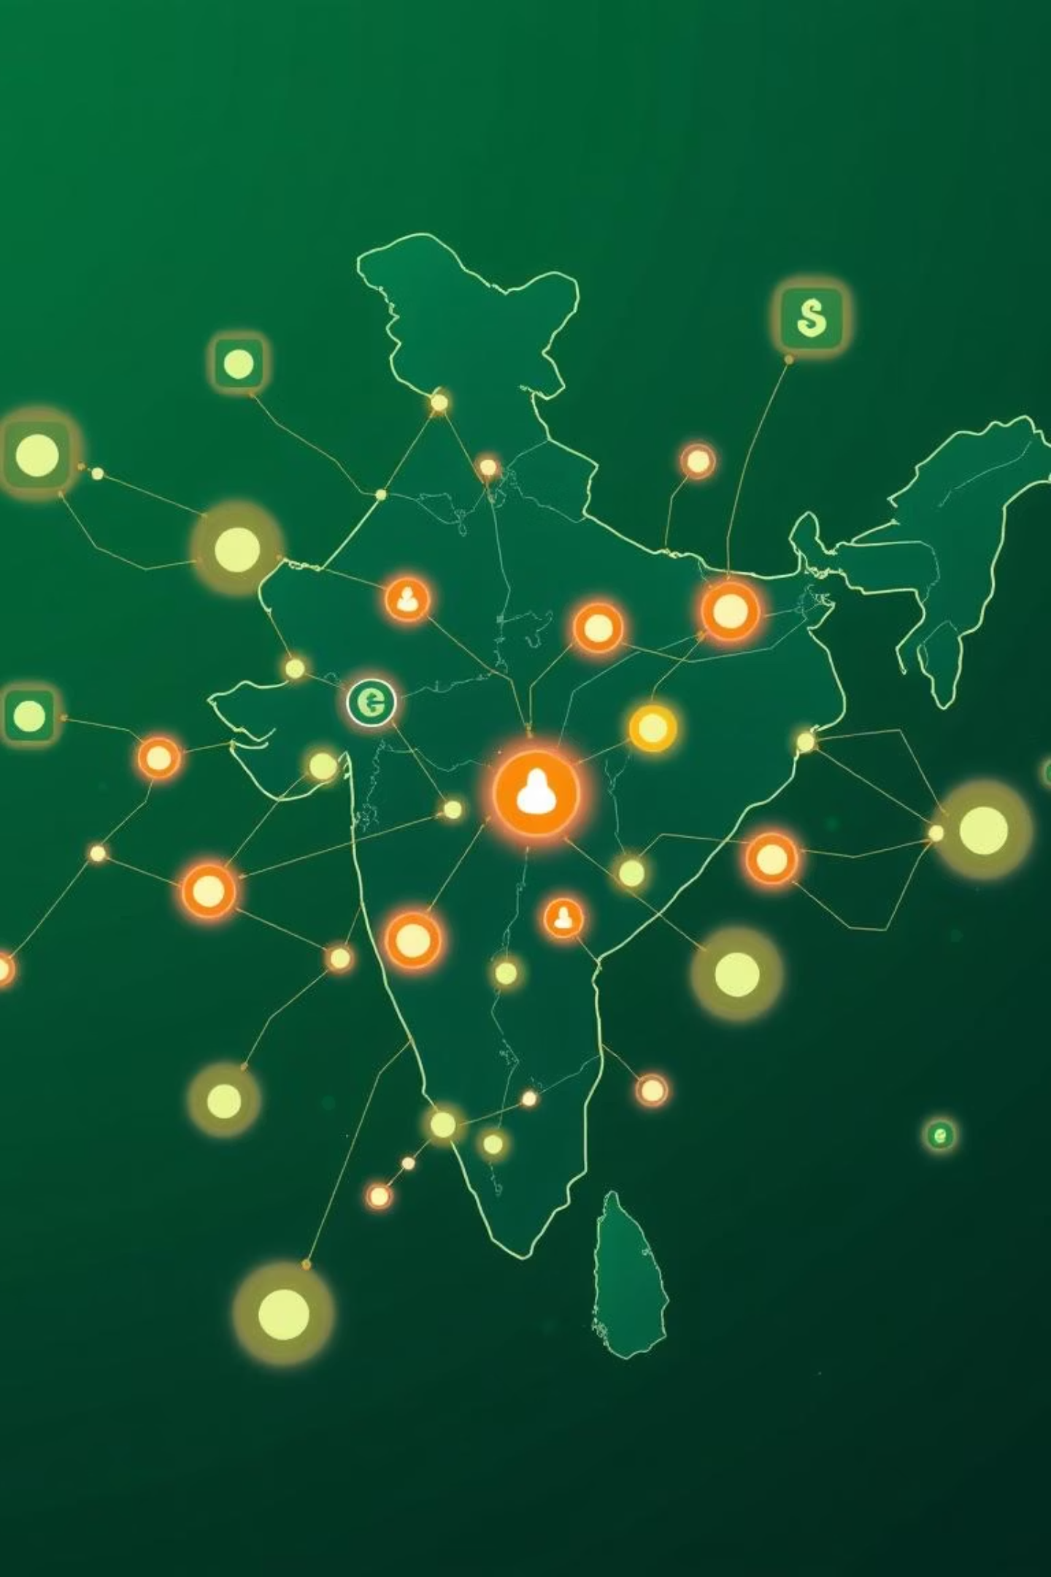
Business Scope Analysis: PhonePe Pulse
Use Case Scenarios & Insights
Prepared by: Bilk Edison Xavier

Slide 2
Unlocking Strategic Insights from Financial Data
1
2
Data Foundation
Analytical Toolkit
PhonePe Pulse transaction & user data
SQL for data manipulation
Sourced from PostgreSQL ETL
Python (Pandas, Plotly) for analysis
Streamlit for interactive dashboards
3
4
Core Objectives
Strategic Application
Identify patterns in transactions
Inform fintech product development
Understand user engagement
Optimise marketing campaigns
Assess insurance sector performance
Guide growth strategy decisions

Slide 3
Key Scenarios for Analysis
Our comprehensive analysis delves into five critical areas to provide a holistic view of the PhonePe Pulse dataset. Each scenario offers unique insights vital for strategic decision-making in the fintech sector.
1
Decoding Transaction Dynamics on PhonePe
Understanding where and how financial transactions are occurring.
2
Insurance Engagement Analysis
Gauging user interaction and awareness of insurance products.
3
Insurance Penetration and Growth Potential
Identifying untapped markets and long-term adoption trends.
4
User Registration Analysis
Tracking new user adoption and regional registration patterns.
5
Insurance Transactions Analysis
Detailing the specifics of insurance purchases and high-demand areas.

Slide 4
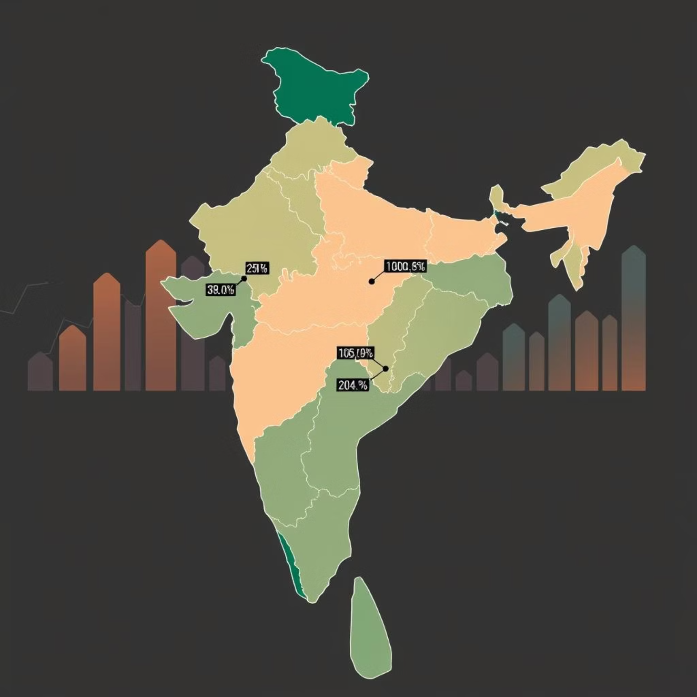
Scenario 1: Decoding Transaction Dynamics
Key Insights:
State- and district-level transaction volumes reveal top-performing regions.
Quarterly and category-wise breakdowns uncover seasonal shifts and consumption patterns.
Analysis identifies areas of growth, stagnation, or decline, providing a granular view of market activity.
Business Scope:
Prioritise marketing investments and product rollouts in high-growth regions. Allocate resources efficiently by focusing on markets with proven transaction momentum.

Slide 5



Scenario 2: Insurance Engagement Analysis
Adoption Metrics
Segment Identification
Engagement Patterns
Measures the rate of adoption and consistent engagement with insurance products across the user base.
Identifies user segments with high awareness versus those with low participation, guiding targeted interventions.
Highlights regional and device-based engagement patterns, informing channel-specific strategies.
Business Scope:
Develop tailored awareness campaigns and incentivise adoption for underperforming segments and regions. Optimise product messaging to resonate with specific user behaviours.

Slide 6
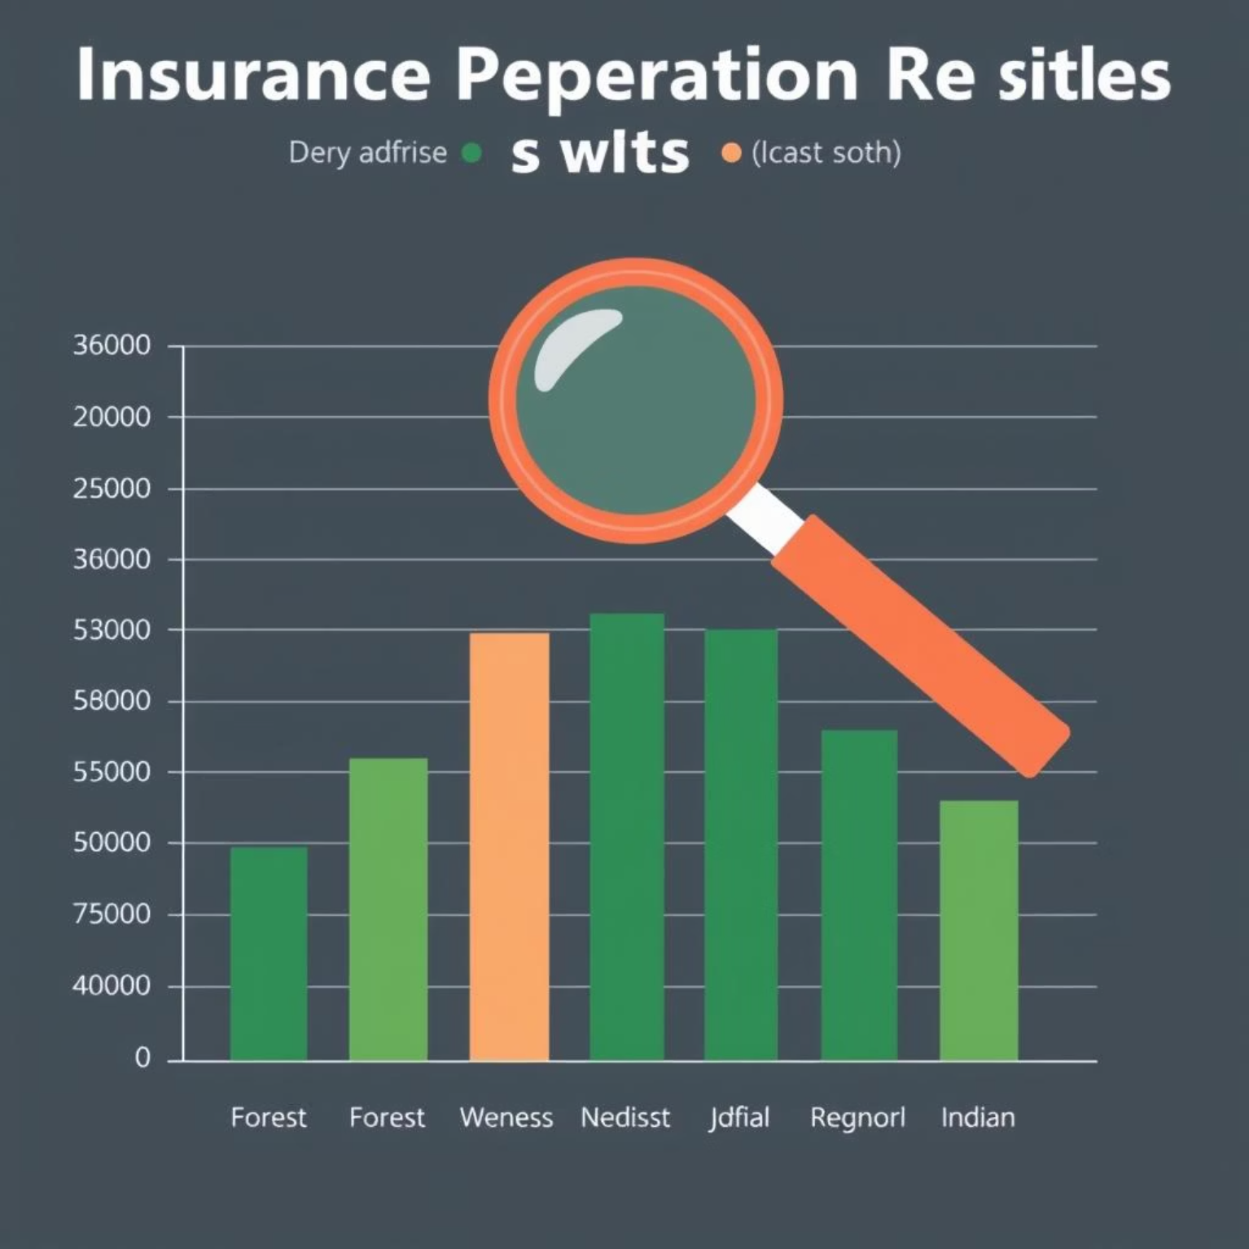
Scenario 3: Insurance Penetration & Growth Potential
This analysis provides a critical long-term outlook on the insurance market within India. By examining penetration rates, we can gauge the maturity of different regions and identify where the greatest opportunities for expansion lie.
State- and district-level penetration rates are benchmarked against national averages.
Highlights the fastest-growing insurance markets and presently underserved geographies.
Provides insights into the long-term adoption trajectory of insurance products, aiding future planning.
Business Scope:
Focus strategic expansion on underpenetrated but high-growth states, investing in infrastructure and partnerships to capture emerging demand.

Slide 7
Scenario 4: User Registration Analysis
Understanding user acquisition is fundamental to scaling fintech operations. This analysis focuses on the patterns and trends in new user registrations across various geographical levels.
1
2
3
Registration Tracking
Growth Hotspots
Predictive Cycles
Tracks registrations across states, districts, and even pincodes, offering granular insights into user origins.
Quarterly and yearly insights pinpoint high-growth regions and emerging markets for user acquisition.
Reveals user adoption cycles, enabling more accurate predictive planning for onboarding initiatives.
Business Scope:
Allocate marketing and operational resources strategically to regions exhibiting fast-growing user bases, optimising acquisition costs and speeding up market penetration.

Slide 8
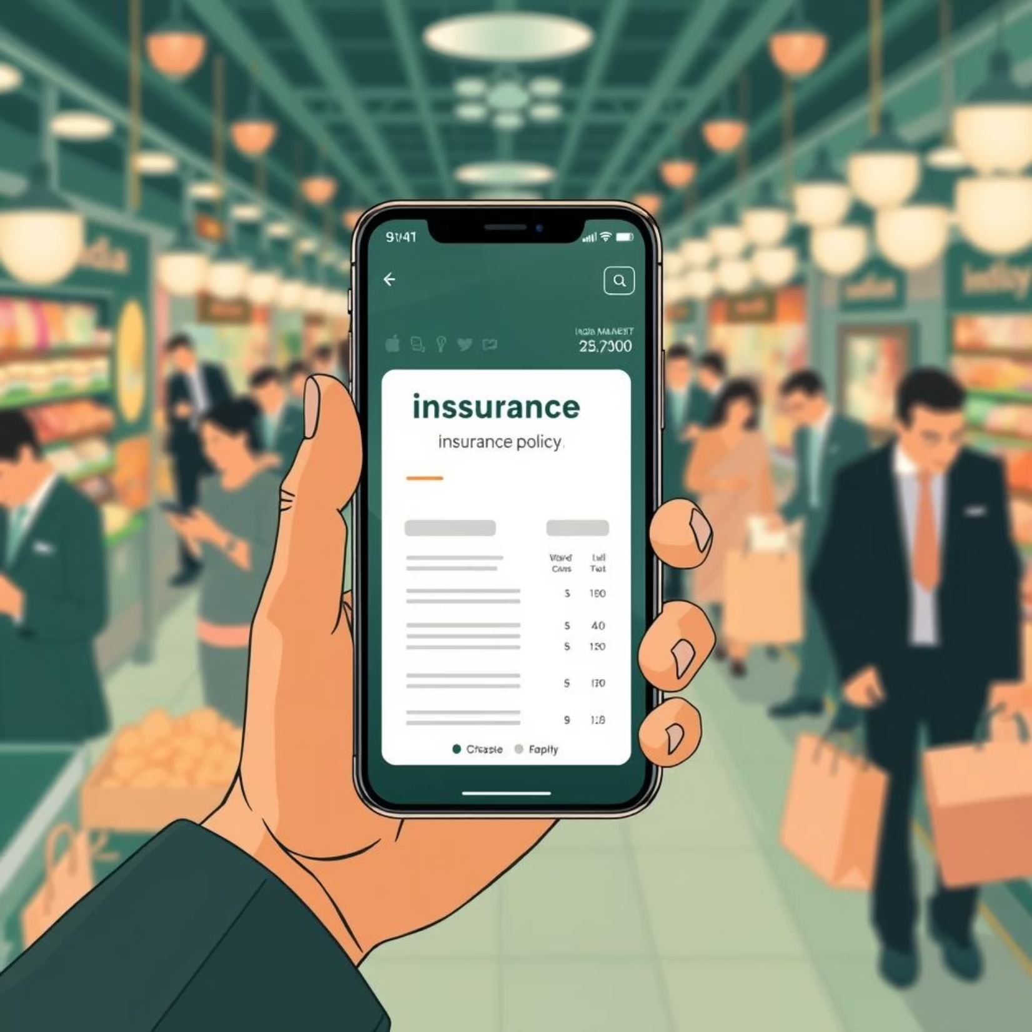
Scenario 5: Insurance Transactions Analysis
Identifies top-performing states and districts specifically for insurance transactions, showing where policies are most actively purchased.
Detects underserved areas with significant untapped insurance demand, highlighting white spaces for market entry.
Provides detailed transaction-level patterns, including policy types, average premiums, and frequency, for deeper market understanding.
Business Scope:
Develop customised insurance offerings and distribution strategies for high-demand areas. Tailor products to meet specific regional needs and preferences.

Slide 9





Strategic Business Opportunities
Leveraging the insights from the PhonePe Pulse data, we can pinpoint key opportunities for growth and market leadership in the dynamic Indian fintech landscape.
Optimise Investments
Boost Engagement
Expand Reach
Invest strategically in top-performing states and transaction categories to maximise returns.
Improve insurance-specific engagement rates through targeted campaigns and user education.
Target the fastest-growing insurance markets and underserved regions for accelerated expansion.
Strengthen Presence
Predictive Growth
Reinforce market presence in high-value districts and pincodes through localised strategies.
Leverage user registration trends for predictive planning and proactive market entry.

Slide 10
Conclusion & Next Steps
The analysis of PhonePe Pulse data provides a robust, data-driven roadmap for strategic fintech expansion within the Indian market. Our findings underscore the importance of targeted interventions and regional focus.
Key Focus Areas:
Prioritising growth states for investment.
Enhancing insurance product penetration.
Capitalising on evolving user base dynamics.
Immediate Next Steps:
Enhance Marketing: Implement hyper-localised marketing campaigns in underutilised segments.
Scale Operations: Rapidly scale infrastructure and personnel in identified growth regions.
Product Localisation: Design region-specific financial products and insurance policies tailored to local needs.

